Slide 1
Module 2.1 / Week 3
Overview of elements of the financial report audit process

Slide 2
Learning Objectives
  3.1 Explain the difference between accounting and auditing and the importance of professional scepticism and professional judgment to auditing.
  3.2 Outline the logical process of identifying financial report assertions, developing specific audit objectives and selecting auditing procedures.
  3.3 Explain the relationships between audit procedures and evidence, and describe common audit procedures used in an audit of a financial report.
  3.4 Define sufficient appropriate audit evidence and its relationship to auditing procedures.
  3.5 Outline the audit risk model.
  3.6 Explain the concept of materiality.
  3.7 Define types of audit tests.
  3.8 Explain how an auditor may use the work of an expert or component auditor.

Slide 3
LO 3.1
            Accounting and Auditing contrasted

Slide 4
Accounting and Auditing contrasted
The financial report is the product of the entity’s accounting system and of judgments made by those charged with governance and management.
ASA 200.3/ISA 200.3: The purpose of the audit is to enhance the degree of confidence of the intended users of the financial report.
To form a judgment on the financial report, the auditor must look behind the financial report to the data and allocations of the data.
Therefore there is a close relationship between accounting and auditing.

Slide 5
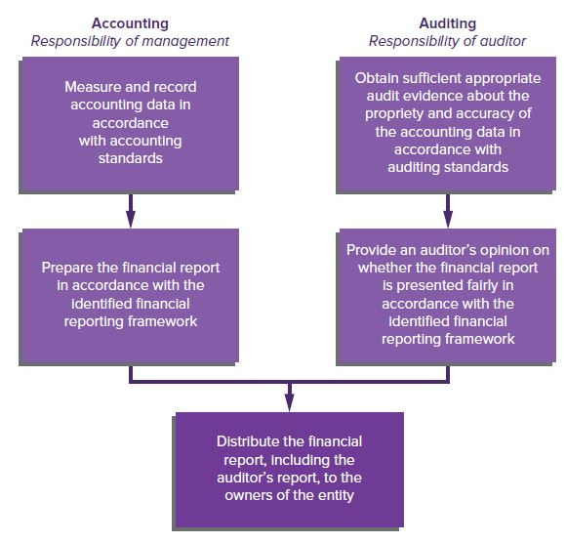
Relationship between Accounting and Auditing
Source: Grant, G. & Simnett, R. (2018). Auditing & Assurance Services In Australia (7th Ed), Sydney, Australia: McGraw Hill

Slide 6
Professional scepticism and professional judgment
Accounting standards allow choice of accounting methods and require accountants to use judgment. Financial reports can also be biased, as preparers have a vested interest in the information contained in the financial report.
Thus the auditor must plan and perform the audit with professional scepticism, a questioning mind and a critical assessment of evidence (ASA 200.15/ISA 200.15).
The auditor must also exercise professional judgment, the application of relevant training, knowledge and experience (ASA 200.16/ISA 200.16).

Slide 7
Areas of Audit Interest
      Accountable activity of the entity:
                collection of original accounting data
                allocations and reclassifications of the associated data
                presentation of results in financial report
      Organisation of the entity:
                internal organisational structure (internal control)
                objectives of internal control are linked with auditor’s concern with flow of transactions through accounting system and the impact of business risk on the entity’s ability to achieve its objectives.
      Business risk:
                Entity’s strategy, environment and risks faced

Slide 8
LO 3.2
Financial report assertions and audit objectives and procedures

Slide 9
Financial Report Assertions
Directors and managers make assertions (embodied in the financial report) when they present a financial report.
Auditors use these assertions to identify and assess risks by considering different types of potential misstatements that may occur and designing audit procedures in response to risks.
There are two categories of assertions:
              Classes of transactions and events and related disclosures
              Account balances and related disclosures

Slide 10
Financial Report Assertions - Classes of Transactions
Occurrence | transactions and events that have been recorded or disclosed have occurred and pertain to the entity.
Completeness | all transactions and events that should have been recorded and all related disclosures that should have been included in the financial report have been included.
Accuracy | amounts and other data relating to recorded transactions and events have been recorded appropriately and related disclosures have been measured and described.
Cut-off | transactions and events have been recorded in the correct accounting period.
Classification | transactions and events have been recorded in the proper accounts.
Presentation | transactions and events are appropriately aggregated or disaggregated and clearly described and related disclosures are relevant and understandable.

Slide 11
Financial Report Assertions - Account Balances
Existence | assets, liabilities and equity interests exist.
Rights and obligations | the entity holds or controls the rights to assets, and liabilities are the obligation of the entity.
Completeness | all assets, liabilities and equity interests that should have been recorded have been recorded and any resulting valuation or allocation adjustments are appropriate recorded and related disclosures have been appropriately measured and described.
Valuation and allocation | assets, liability and equity interests are included in the financial report at appropriate amounts and any resulting valuation adjustments are appropriately recorded.
Classification | assets, liabilities and equity interests have been recorded in the proper accounts.
Presentation | assets, liabilities and equity interests are appropriately aggregated or disaggregated and clearly described and related disclosures are relevant and understandable.

Slide 12
LO 3.3
Audit Procedures and Evidence

Slide 13
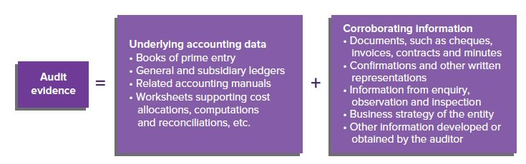
Audit Procedures and Evidence
Audit procedures are the actions that an auditor takes in acquiring evidence.
ASA 500.5 (ISA 500.5) defines audit evidence as all of the information used by the auditor in arriving at the conclusions on which the audit opinion is
Source: Grant, G. & Simnett, R. (2018). Auditing & Assurance Services In Australia (7th Ed), Sydney, Australia: McGraw Hill

Slide 14
Common Audit Procedures
Inspection
Observation
External confirmation
Recalculation
Re-performance
Analytical procedures
Enquiry (ASA/ISA 500.A14-A25

Slide 15
Common Audit Procedures
The selection of audit procedures is influenced by the following factors:
                auditor’s understanding of entity and environment
                auditor’s assessment of business risk and inherent risk
                nature of the internal control structure and auditor’s assessment of control risk
                materiality of components of financial report
                experience gained from previous audits
                results of other audit procedures
                source and reliability of information available
                persuasiveness of audit evidence obtained.

Slide 16
LO 3.4
Sufficient appropriate audit evidence

Slide 17
Sufficient appropriate audit evidence
Procedures selected should provide sufficient appropriate audit evidence for the auditor to form conclusions concerning the validity of individual assertions embodied in the components of the financial report and to give an auditor’s opinion (ASA 200/ISA 200 and ASA 500/ISA 500).
Sufficiency: quantity of audit evidence necessary to provide the auditor with a reasonable basis for an opinion on the financial report. Quite often determined by reference to sampling (Chapter 10).
Appropriateness: refers to the quality of audit evidence.

Slide 18
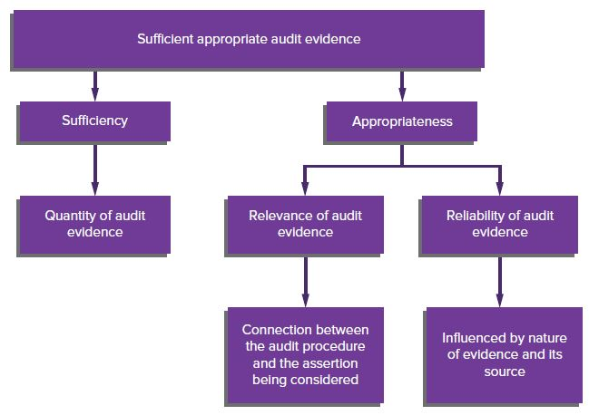
Components of sufficient appropriate audit evidence
Source: Grant, G. & Simnett, R. (2018). Auditing & Assurance Services In Australia (7th Ed), Sydney, Australia: McGraw Hill

Slide 19
Reliability of Audit Evidence
Reliability of audit evidence is influenced by nature and source:
    Evidence from sources outside an entity is more reliable than evidence obtained solely from within the entity.
    Evidence generated internally is more reliable when the internal control structures are effective.
    Evidence obtained directly by the auditor is more reliable than evidence obtained from the client.
    Evidence in the form of documents or written representations is more reliable than oral representations.
    Evidence provided by original documents is more reliable than evidence provided by photocopies or facsimiles (ASA 500.A31/ISA 500.A31).

Slide 20
LO 3.5
Overview of the Audit Risk Model

Slide 21
The Audit Risk Model
                Audit risk is the risk that the auditor will give an inappropriate audit opinion when the financial report is materially misstated (ASA 200; ISA 200).
                This means the auditor gives an opinion that the financial report is true and fair when it contains a significant error or fraud.
                Before issuing an opinion on the financial report, the auditor needs to reduce audit risk to an acceptable level to ensure the opinion is reliable.
                The audit risk model focuses audit effort on those classes of transactions or balances
                (and the particular assertions) that are likely to contain material misstatements.

Slide 22
Components of Audit Risk
Audit risk is the function of the risk of material misstatement and of detection (ASA 200/ISA 200).
Risk of material misstatement (RMM): ‘Risk that financial report is materially misstated prior to audit.’
May exist at:
              overall financial report level for risks that are pervasive to financial report as a whole and may affect many assertions (e.g. going concern risk)
              assertion level for classes of transactions, balances and disclosures (ASA 200/ISA 200).

Slide 23
Risk of Material Misstatement
    At assertion level, the RMM is a combination of inherent and control risk (inherently risky items will increase RMM, but this risk is reduced if proper controls implemented).
                Inherent risk (IR): Susceptibility of an assertion to material misstatement given inherent and environmental characteristics, but without regard to prescribed control procedures.
                Control risk (CR): Risk that material misstatement might not be prevented or detected by internal control procedures.
    Detection risk (DR): Risk that auditors’ substantive procedures will lead auditor to conclude no material misstatement exists when, in fact, one does.

Slide 24
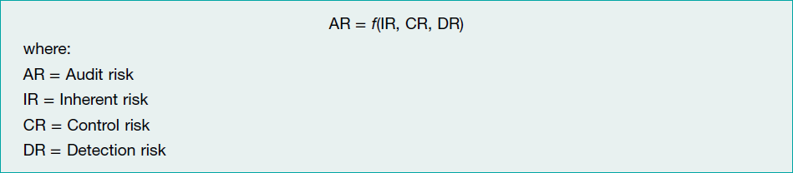
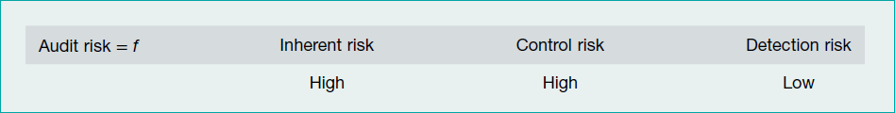
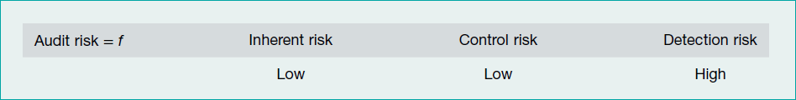
Audit Risk Model and Relations
  There is an inverse relationship between IR and CR and DR.

Slide 25
Reducing Audit Risk
                Auditors cannot change inherent risk.
                Auditors cannot directly change control risk, they can assess level of control risk that is less than high (expect to rely on internal control) by examining the entity's internal control and testing its effectiveness.
                The auditor can alter the level of detection risk. Auditor can reduce detection risk and therefore audit risk by (ASA/ISA 200.A43):
                adequate planning
                proper assignment of personnel to audit engagement team
                application of professional scepticism
                appropriate decisions on nature, timing and extent of audit procedures
                effective performance of audit procedures and evaluation of results
                supervision and review of audit work performed.

Slide 26
LO 3.6
Materiality

Slide 27
Materiality
                Auditor must make preliminary assessment of materiality when planning the audit.
                ‘Materiality’ defined as information, individually or in aggregate, that if misstated or omitted from a financial report may adversely affect decisions about the allocation of scarce resources made by financial report users (ASA/ISA 320.2).
                Auditor must determine materiality level for the:
                Financial report as a whole
                Particular classes of transactions, account balances and disclosures.

Slide 28
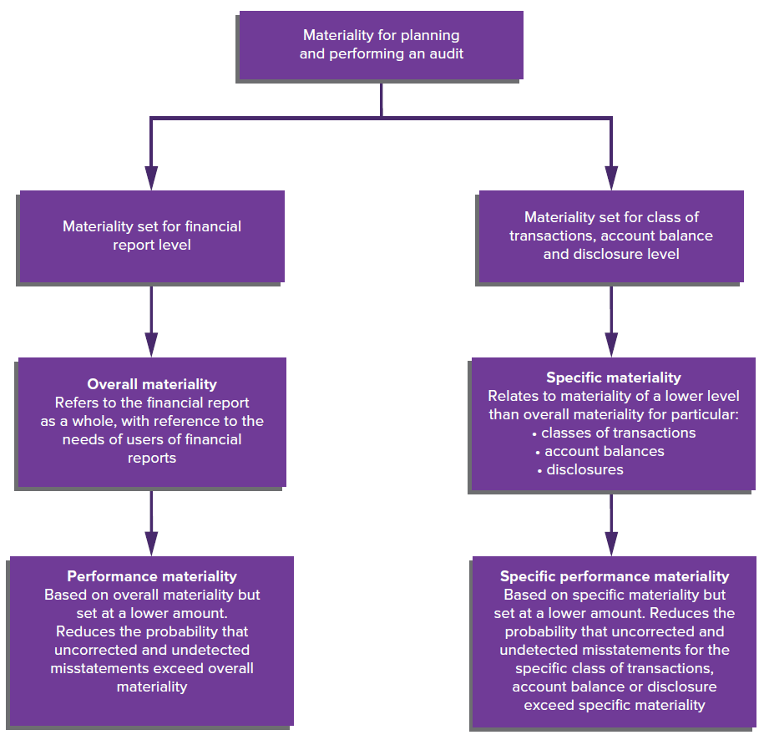
Materiality Levels
Source: Grant, G. & Simnett, R. (2018). Auditing & Assurance Services In Australia (7th Ed), Sydney, Australia: McGraw Hill

Slide 29
Qualitative and Quantitative Materiality
  Information is material if it impacts on the decision-making process of users of the financial report.
QUALITATIVE MATERIALITY
NATURE OF THE ITEM
Fraud
Non-compliance with laws
Related party transactions
Change of accounting methods
QUANTITATIVE MATERIALITY
MAGNITUDE OF ITEM
Set as a % of relevant base

Slide 30
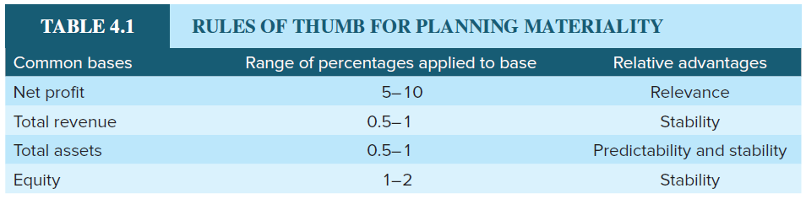
Setting Materiality
                Used in practice to refer to ‘materiality for the financial report as a whole’.
                Auditor uses professional judgement.
                Audit firms vary in methods to set materiality percentages in the risk assessment phase to derive at an appropriate base percentage.
                Balance sheet bases include total assets or equity.
                Income statement bases include profit before tax, revenue or gross profit.
                Setting lower materiality level during planning increases quality and quantity of evidence required to be gathered.
Source: Grant, G. & Simnett, R. (2018). Auditing & Assurance Services In Australia (7th Ed), Sydney, Australia: McGraw Hill

Slide 31
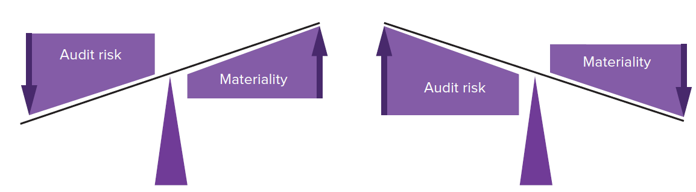
Inverse relationship between materiality and audit risk
Source: Grant, G. & Simnett, R. (2018). Auditing & Assurance Services In Australia (7th Ed), Sydney, Australia: McGraw Hill

Slide 32
LO 3.7
Types of Audit Test

Slide 33

Types of Audit Tests
Tests of Controls
Substantive Tests

Slide 34
Types of Audit Procedures
Audit Procedures
Substantive Procedures
Test of Details
Substantive Analytical Procedures
Test of Controls
Test Of Balances
Test of Transactions
Test of Disclosure

Slide 35
Tests of Control
        An auditor performs tests of control to obtain evidence about whether the control activities of the internal control system are effective.
        Involves obtaining evidence about:
                design of policies or procedures
                operating effectiveness of these policies or procedures (implementation).
        The tests are designed to provide evidence to support an assessment of control risk at a level below high (indicating reliance on the key controls).

Slide 36
Types of Substantive Tests
Substantive Tests
        Performed on specific transactions and balances to see whether the dollar amount of an account balance is materially misstated.
        These tests reduce detection risk.
        Analytical procedures: involve the study and comparison of relationships between accounting data and related information.
        Tests of details: obtaining evidence on the items (or details) included in an account balance or class of transactions:
                substantive tests of transactions
                substantive tests of balances
                substantive tests of disclosures.

Slide 37
LO 3.8
Using the work of an expert or component auditor

Slide 38
Using the work of an expert or component auditor
        Given the complexity and specialised nature of many client operations, auditors often unable to service clients effectively without using experts.
        Experts are either:
                Management’s expert, help entity prepare the financial report, or
                Auditor’s expert, employed by auditor to assist in obtaining sufficient appropriate audit evidence.
                Audit firms develop industry specialisations, have knowledge management systems supporting the specialisations and have employees designated as specialists by industry, function or technical area.

Slide 39
Ensuring that work by an expert is adequate
An auditor should:
        assess capabilities and competence of the expert
        assess objectivity of the expert
        obtain an understanding of the work of the expert
        evaluate the appropriateness of the work of the expert for the relevant assertion by:
            discussing or reviewing reasonableness of assumptions and methods used
            considering relevance, completeness and accuracy of source data used
            considering consistency of expert’s work with results of other audit procedures.

Slide 40
Using the work of a component auditor
                Audit work for a client may also be undertaken by a number of different auditors (consider a consolidated entity with subsidiaries in many countries).
                The principal auditor retains responsibility for the overall auditor’s opinion and must ensure the procedures used by component auditors are appropriate for the principal auditor’s purpose.

Slide 41
References
Grant, G. & Simnett, R. (2017). Auditing & Assurance Services In Australia (rev: 6th Ed), Sydney, Australia: McGraw Hill
Moroney, R., Campbell, F., & Hamilton, J., (2017). Auditing: A Practical Approach, 3rd edition, Sydney, Australia: Wiley

